Slide 1
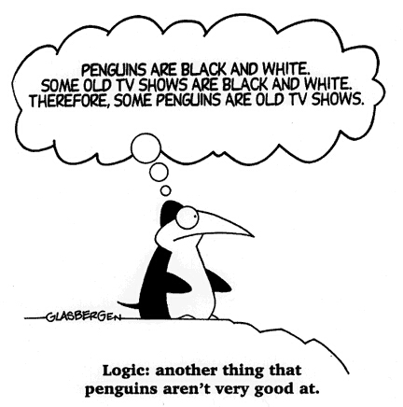
Chapters 8 & 9 First-Order Logic
Dr. Daisy Tang
In which we notice that the world is blessed with objects, some of which are related to other objects, and in which we endeavor to reason about them.

Slide 2
Outline
Why FOL?
Syntax and semantics of FOL
Using FOL
Wumpus world in FOL
Inference in FOL

Slide 3
Pros and Cons of Pro. Logic
☺ Propositional logic is declarative ☺ Propositional logic allows partial/disjunctive/negated information
unlike most data structures and databases, which are domain-specific
☺ Propositional logic is compositional
meaning of B_{1,1} ∧ P_{1,2} is derived from meaning of B_{1,1} and of P_{1,2}
☺ Meaning in propositional logic is context-independent
(unlike natural language, where meaning depends on context)
☹ Propositional logic has very limited expressive power
(unlike natural language)
E.g., cannot say "pits cause breezes in adjacent squares“
except by writing one sentence for each square

Slide 4
Our Approach
Adopt the foundation of propositional logic – a declarative, compositional semantics that is context-independent and unambiguous – but with more expressive power, borrowing ideas from natural language while avoiding its drawbacks
Important elements in natural language:
Objects (squares, pits, wumpuses)
Relations among objects (is adjacent to, is bigger than) or unary relations or properties (is red, round)
Functions (father of, best friend of)
First-order logic (FOL) is built around the above 3 elements

Slide 5
Identify Objects, Relations, Functions
One plus two equals three.
Squares neighboring the wumpus are smelly.
Evil King John ruled England in 1200.

Slide 6
Prop. Logic vs. FOL
Propositional logic assumes that there are facts that either hold or do not hold
FOL assumes more: the world consists of objects with certain relations among them that do or do not hold
Other special-purpose logics:
Temporal logic: facts hold at particular times / T,F,U
E.g., “I am always hungry”, “I will eventually be hungry”
Higher-order logic: views the relations and functions in FOL as objects themselves / T,F,U
Probability theory: facts / degree of belief [0, 1]
Fuzzy logic: facts with degree of truth [0, 1] / known interval values
E.g, “the temperature is very hot, hot, normal, cold, very cold”

Slide 7
First-Order Logic (FOL)
Whereas propositional logic assumes the world contains facts
First-order logic (like natural language) assumes the world contains
Objects: people, houses, numbers, colors, baseball games, wars, …
Relations: red, round, prime, brother of, bigger than, part of, comes between, …
Functions: father of, best friend, one more than, plus, …

Slide 8
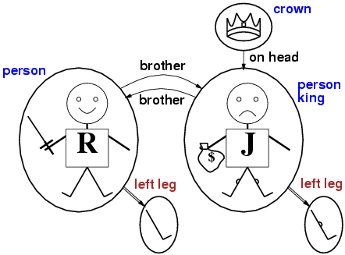
Models for FOL: Example

Slide 9
Example
Five objects
Two binary relations
Three unary relations
One unary function

Slide 10
Syntax of FOL: Basic Elements
Basic symbols: objects (constant symbols), relations (predicate symbols), and functions (functional symbols).
Constants King John, 2, Wumpus...
Predicates Brother, >,...
Functions Sqrt, LeftLegOf,...
Variables x, y, a, b,...
Connectives ¬, ⇒, ∧, ∨, ⇔
Equality =
Quantifiers ∀, ∃
A legitimate expression of predicate calculus is called well-formed formula (wff), or simply, sentence

Slide 11
Relations (Predicates)
A relation is the set of tuples of objects
Brotherhood relationship {<Richard, John>, <John, Richard>}
Unary relation, binary relation, …
Example: set of blocks {a, b, c, d, e}
The “On” relation includes:
On = {<a,b>, <b,c>, <d,e>}
the predicate On(A,B) can be interpreted as <a,b> Є On.
a
b
d
c
e

Slide 12
Functions
In English, we use “King John’s left leg” rather than giving a name to his leg, where we use “function symbol”
hat(c) = b
hat(b) = a
hat(d) is not defined
a
b
d
c
e

Slide 13
Terms and Atomic Sentences
Atomic sentence = predicate (term₁,...,term_{n}) or term₁ = term₂
Term = function (term₁,...,term_{n}) or constant or variable
Atomic sentence states facts
Term refers to an object
For example:
Brother(KingJohn,RichardTheLionheart)
Length(LeftLegOf(Richard))
Married(Father(Richard), Mother(John))

Slide 14
Composite Sentences
Complex sentences are made from atomic sentences using connectives ¬S, S₁ ∧ S₂, S₁ ∨ S₂, S₁ ⇒ S₂, S₁ ⇔ S₂
For example:

Slide 15
Intended Interpretation
The semantics relate sentences to models to determine truth
Interpretation specifies exactly which objects, relations and functions are referred to by the constant, predicate, and function symbols
Richard refers to Richard the Lionheart and John refers to the evil King John
Brother refers to the brotherhood relation; Crown refer to the set of objects that are crowns
LeftLeg refers to the “left leg” function
There are many other possible interpretations that relate symbols to model; Richard refers to the crown
If there are 5 objects in the model, how many possible interpretations are there for two symbols Richard and John?

Slide 16
Intended Interpretation (Con’t)
The truth of any sentence is determined by a model and an interpretation for the sentence’s model
The entailment and validity are defined in terms of all possible models and all possible interpretations
The number of domain elements in each model may be unbounded; thus the number of possible models is unbounded
Checking entailment by enumeration of all possible models is NOT doable for FOL

Slide 17
In General
Sentences are true with respect to a model and an interpretation
Model contains objects (domain elements) and relations among them
Interpretation specifies referents for
constant symbols → objects predicate symbols → relations function symbols → functional relations
Once we have a logic that allows objects, it is natural to want to express properties of entire collections of objects, instead of enumerating the objects by name → Quantifiers

Slide 18
Universal Quantifier
Universal quantification (∀)
“All kings are person”: ∀x King(x) ⇒ Person(x)
For all x, if x is a king, then x is a person
In general, ∀x P is true in a given model under a given interpretation if P is true in all possible extended interpretations
In the above example, x could be one of the following:
Richard, John, Richard’s left leg, John’s left leg, Crown
5 extended interpretations
A common mistake: ∀x (King(x) ^ Person(x))

Slide 19
Existential Quantifier
Existential quantification (∃)
∃x Crown(x) ∧ OnHead(x, John)
There is an x such that x is a crown and x is on the John’s head
In general, ∃x P is true in a given model under a given interpretation if P is true in at least one extended interpretation that assigns x to a domain element
In the above example, “Crown(crown) ∧ OnHead(crown, John)” is true
Common mistake: ∃x Crown(x) ⇒ OnHead(x, John)

Slide 20
Nested Quantifiers
Nested quantifiers
∀x ∀y [Brother(x, y) ⇒ Sibling(x, y)]
∀x ∃y Loves(x, y)
∃y ∀x Loves(x, y)
∃x ∀y is not the same as ∀y ∃x
The order of quantification is important
Quantifier duality: each can be expressed using the other
∀x Likes(x,IceCream) ¬∃x ¬Likes(x,IceCream)
∃x Likes(x,Broccoli) ¬∀x ¬Likes(x,Broccoli)

Slide 21
Equality
term₁ = term₂ is true under a given interpretation if and only if term₁ and term₂ refer to the same object
Can be used to state facts about a given function
E.g., Father(John) = Henry
Can be used with negation to insist that two terms are not the same object
E.g., definition of Sibling in terms of Parent: ∀x,y Sibling(x,y) ⇔ [¬(x = y) ∧ ∃m,f ¬ (m = f) ∧ Parent(m,x) ∧ Parent(f,x) ∧ Parent(m,y) ∧ Parent(f,y)]

Slide 22
Using FOL
Sentences are added to a KB using TELL, which is called assertions
Questions asked using ASK are called queries
Any query that is logically entailed by the KB should be answered affirmatively
The standard form for an answer is a substitution or binding list, which is a set of variable/term pairs

Slide 23
Example: The Kinship Domain
An example KB includes things like:
Fact:
“Elizabeth is the mother of Charles”
“Charles is the father of William”
Rules:
One’s grandmother is the mother of one’s parent”
Object: people
Unary predicate: Male, Female
Binary predicate: Son, Spouse, Wife, Husband, Grandparent, Grandchild, Cousin, Aunt, and Uncle
Function: Mother, Father

Slide 24
Example: The Kinship Domain
In-Class Exercise #8.1:
Male and female are disjoint categories
A sibling is another child of one’s parents

Slide 25
The Wumpus World
A percept is a binary predicate:
Percept([Stench, Breeze, Glitter, None, None], 5)
Actions are logical terms:
Turn(Right), Turn(Left), Forward, Shoot, Grab, Release, Climb
Query:
∃a BestAction(a, 5)
Answer: {a/Grab}
Perception: percept implies facts:
∀ t, s, b, m, c Percept([s, b, Glitter, m, c], t) ⇒ Glitter(t)
Reflex behavior:
∀ t Glitter(t) ⇒ BestAction(Grab, t)

Slide 26
The Wumpus World
The Environment:
Objects: squares, pits and the wumpus
∀x,y,a,b Adjacent([x,y],[a,b]) ⇔
[a,b] ∈ {[x+1,y], [x-1,y],[x,y+1],[x,y-1]}
A unary predicate Pit(x)
∀s,t At(Agent,s,t) ∧ Breeze(t) ⇒ Breezy(s), the agent infers properties of the square from properties of its current percept
Breezy() has no time argument
Having discovered which places are breezy or smelly, not breezy or not smelly, the agent can deduce where the pits are and where the wumpus is

Slide 27
Diagnostic Rules
Diagnostic rule: lead from observed effects to hidden causes
If the square is breezy then adjacent square(s) must contain a pit
∀s Breezy(s) ⇒ ∃r Adjacent(r,s) ∧ Pit(r)
If the square is not breezy, no adjacent square contains a pit
∀s ¬Breezy(s) ⇒ ¬ (∃r Adjacent(r,s) ∧ Pit(r))
Combining both:
∀s Breezy(s) ⇔ ∃r Adjacent(r,s) ∧ Pit(r)

Slide 28
Causal Rules
Causal rule: some hidden property of the world causes certain percept to be generated
A pit causes all adjacent squares to be breezy
∀r Pit(r) ⇒ [∀s Adjacent(r,s) ⇒ Breezy(s)]
If all squares adjacent to a given square are pitless, the square will not be breezy
∀s [∀r [Adjacent(r,s) ⇒ ¬Pit(r)] ⇒ ¬Breezy(s)

Slide 29
Summary
First-order logic:
objects and relations are semantic primitives
syntax: constants, functions, predicates, equality, quantifiers
Increased expressive power: sufficient to define wumpus world

Slide 30
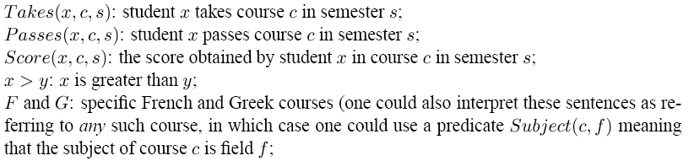
In-Class Exercise #8.2
Represent the following sentences in FOL
Some students took French in spring 2001.
Every student who takes French passes it.
Only one student took Greek in spring 2001.
The best score in Greek is always higher than the best score in French.
Let the basic vocabulary be as follows:

Slide 31
Inference in FOL
Two ideas:
convert the KB to propositional logic and use propositional inference
a shortcut that manipulates on first-order sentences directly (resolution, will not be introduced here)

Slide 32
Universal Instantiation
Universal instantiation
infer any sentence by substituting a ground term (a term without variables) for the variable
∀v α Subst({v/g}, α)
for any variable v and ground term g
Examples
∀x King(x) ∧ Greedy(x) ⇒ Evil(x) yields:
King(John) ∧ Greedy(John) ⇒ Evil(John)
King(Richard) ∧ Greedy(Richard) ⇒ Evil(Richard)
King(Father(John)) ∧ Greedy(Father(John)) ⇒ Evil(Father(John))

Slide 33
Existential Instantiation
Existential instantiation
For any sentence α, variable v, and constant symbol k that does NOT appear elsewhere in the knowledge base, replace v with k
∃v α
Subst({v/k}, α)
E.g., ∃x Crown(x) ∧ OnHead(x, John) yields:
Crown(C₁) ∧ OnHead(C₁, John)
provided C₁ is a new constant symbol, called a Skolem constant

Slide 34
In-Class Exercise #8.3
Suppose a knowledge base contains just one sentence, ∃x AsHighAs(x, Everest). Which of the following are legitimate results of applying Existential Instantiation?
AsHighAs(Everest, Everest)
AsHighAs(Kilimanjaro, Everest)
AsHighAs(Kilimajaro, Everest) and AsHighAs(BenNevis, Everest)

Slide 35
Reduction to Propositional Inference
Suppose the KB contains just the following: ∀x King(x) ∧ Greedy(x) ⇒ Evil(x)
King(John)
Greedy(John)
Brother(Richard,John)
Instantiating the universal sentence in all possible ways, we have:
King(John) ∧ Greedy(John) ⇒ Evil(John)
King(Richard) ∧ Greedy(Richard) ⇒ Evil(Richard)
King(John)
Greedy(John)
Brother(Richard,John)
The new KB is propositionalized: proposition symbols are King(John), Greedy(John), Evil(John), King(Richard), etc.
What conclusion can you get?

Slide 36
Reduction Cont’d.
Every FOL KB can be propositionalized so as to preserve entailment
(A ground sentence is entailed by new KB iff entailed by original KB)
Idea: propositionalize KB and query, apply resolution, return result

Slide 37
Problems with Propositionalization
Propositionalization seems to generate lots of irrelevant sentences
E.g., from:
∀x King(x) ∧ Greedy(x) ⇒ Evil(x)
King(John)
∀y Greedy(y)
Brother(Richard,John)
It seems obvious that Evil(John) is true, but propositionalization produces lots of facts such as Greedy(Richard) that are irrelevant
With p k-ary predicates and n constants, there are p·n^{k} instantiations

Slide 38
Problems with Propositionalization
When the KB includes a function symbol, the set of possible ground term substitutions is infinite
Father(Father(…(John)…))
Theorem:
If a sentence is entailed by the original, first-order KB, then there is a proof involving just a finite subset of the propositionalized KB
First instantiation with constant symbols
Then terms with depth 1 (Father(John))
Then terms with depth 2 …
Until the sentence is entailed

Slide 39
Unification and Lifting
Propositionalization approach is rather inefficient

Slide 40
A First-Order Inference Rule
If there is some substitution θ that makes the premise of the implication identical to sentences already in the KB, then we assert the conclusion of the implication, after applying θ
Sometimes, we need to do is find a substitution θ both for the variables in the implication and in the sentence to be matched
∀x King(x) ∧ Greedy(x) ⇒ Evil(x)
King(John)
Greedy(John)
What’s θ here?
∀x King(x) ∧ Greedy(x) ⇒ Evil(x)
King(John)
∀y Greedy(y)
Brother(Richard,John)
What’s θ here?

Slide 41
Generalized Modus Ponens
For atomic sentences p_{i}, p_{i}’, and q, where there is a substitution θ such that Subst(θ, p_{i}’) = Subst(θ, p_{i}), for all i:
p₁', p₂', … , p_{n}', ( p₁ ∧ p₂ ∧ … ∧ p_{n} ⇒q)
Subst(θ, q)
p₁' is King(John) p₁ is King(x)
p₂' is Greedy(y) p₂ is Greedy(x)
θ is {x/John,y/John} q is Evil(x)
Subst(θ, q) is Evil(John)
Can be used with KB of definite clauses (exactly one positive literal)

Slide 42
Unification
GMP is a lifted version of Modus Ponens – raises Modus Ponens from propositional to first-order logic
What’s the key advantage of GMP over propositionalization?
Lifted inference rules require finding substitutions that make different logical expressions look identical
This process is called unification and is a key component of all first-order inference algorithms

Slide 43
Unification
The unify algorithm takes two sentences and returns a unifier for them if one exists:
UNIFY(p, q) = θ where Subst(θ, p) = Subst(θ, q)
p q θ
Knows(John,x) Knows(John,Jane)
Knows(John,x) Knows(y,OJ)
Knows(John,x) Knows(y,Mother(y))
Knows(John,x) Knows(x,OJ)

Slide 44
Unification
The unify algorithm takes two sentences and returns a unifier for them if one exists:
UNIFY(p, q) = θ where Subst(θ, p) = Subst(θ, q)
p q θ
Knows(John,x) Knows(John,Jane) {x/Jane}
Knows(John,x) Knows(y,OJ)
Knows(John,x) Knows(y,Mother(y))
Knows(John,x) Knows(x,OJ)

Slide 45
Unification
The unify algorithm takes two sentences and returns a unifier for them if one exists:
UNIFY(p, q) = θ where Subst(θ, p) = Subst(θ, q)
p q θ
Knows(John,x) Knows(John,Jane) {x/Jane}
Knows(John,x) Knows(y,OJ) {x/OJ,y/John}
Knows(John,x) Knows(y,Mother(y))
Knows(John,x) Knows(x,OJ)

Slide 46
Unification
The unify algorithm takes two sentences and returns a unifier for them if one exists:
UNIFY(p, q) = θ where Subst(θ, p) = Subst(θ, q)
p q θ
Knows(John,x) Knows(John,Jane) {x/Jane}
Knows(John,x) Knows(y,OJ) {x/OJ,y/John}
Knows(John,x) Knows(y,Mother(y)) {y/John,x/Mother(John)}
Knows(John,x) Knows(x,OJ)

Slide 47
Unification
The unify algorithm takes two sentences and returns a unifier for them if one exists:
UNIFY(p, q) = θ where Subst(θ, p) = Subst(θ, q)
p q θ
Knows(John,x) Knows(John,Jane) {x/Jane}
Knows(John,x) Knows(y,OJ) {x/OJ,y/John}
Knows(John,x) Knows(y,Mother(y)) {y/John,x/Mother(John)}
Knows(John,x) Knows(x,OJ) {fail}
Standardizing apart: renaming variables to avoid name clashes
UNIFY(Knows(John, x), Knows(z, OJ)) = {x/OJ, z/John}

Slide 48
Unification Contd.
To unify Knows(John, x) and Knows(y, z),
θ = { y/John, x/z } or θ = { y/John, x/John, z/John}
The first unifier is more general than the second
There is a single most general unifier (MGU)
MGU = {y/John, x/z}

Slide 49
In-Class Exercise #8.4
For each pair of atomic sentences, give the most general unifier if it exists:
P(A, B, B), P(x, y, z)
Q(y, G(A, B)), Q(G(x, x), y)
Older(Father(y), y), Older(Father(x), John)
Knows(Father(y), y), Knows(x, x)

Slide 50
Example Knowledge Base
The law says that it is a crime for an American to sell weapons to hostile nations. The country Nono, an enemy of America, has some missiles, and all of its missiles were sold to it by Colonel West, who is American.
Prove that Colonel West is a criminal
American(x): x is an American
Weapon(x): x is a weapon
Hostile(x): x is a hostile nation
Criminal(x): x is a criminal
Missile(x): x is a missile
Owns(x, y): x owns y
Sells(x, y, z): x sells y to z
Enemy(x, y): x is an enemy of y
Constants: America, Nono, West

Slide 51
Example Knowledge Base
First-Order Definite Clauses
... it is a crime for an American to sell weapons to hostile nations:
American(x) ∧ Weapon(y) ∧ Sells(x,y,z) ∧ Hostile(z) ⇒ Criminal(x)
Nono … has some missiles, i.e., ∃x Owns(Nono,x) ∧ Missile(x):
Owns(Nono,M₁) and Missile(M₁)
… all of its missiles were sold to it by Colonel West
Missile(x) ∧ Owns(Nono, x) ⇒ Sells(West, x,Nono)
Missiles are weapons:
Missile(x) ⇒ Weapon(x)
An enemy of America counts as "hostile“:
Enemy(x, America) ⇒ Hostile(x)
West, who is American …
American(West)
The country Nono, an enemy of America …
Enemy(Nono,America)

Slide 52
Forward Chaining
Starting from known facts, it triggers all the rules whose premises are satisfied, adding their conclusions to the known facts. This process will continue until query is answered.
When a new fact P is added to the KB:
For each rule such that P unifies with a premise
if the other premises are already known
then add the conclusion to the KB and continue chaining
Forward chaining is data-driven:
inferring properties and categories from percepts

Slide 53
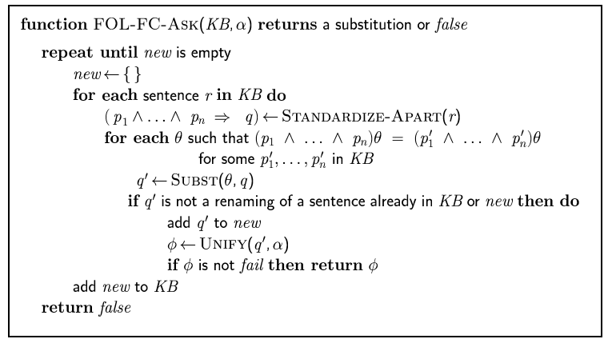
Forward Chaining Algorithm

Slide 54
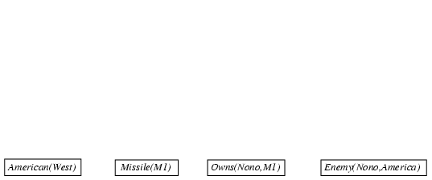
Forward Chaining Proof

Slide 55
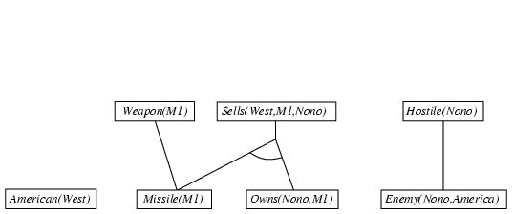
Forward Chaining Proof

Slide 56
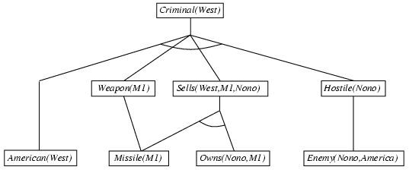
Forward Chaining Proof

Slide 57
Analysis of Forward Chaining
A fixed point of the inference process can be reached
The algorithm is sound and complete
Its efficiency can be improved

Slide 58
FC Algorithm Analysis

Slide 59
Sources of Complexity
1. “Inner loop” involves finding all possible unifiers such that the premise of a rule unifies with facts in the KB
Often called “pattern matching”, very expensive
2. The algorithm rechecks every rule on every iteration to see whether its premises are met
3. It might generate many facts that are irrelevant to the goal

Slide 60
Matching Rules Against Known Facts
Consider a rule:
Owns(Nono, x)∧Missile(x) ⇒ Sells(West, x, Nono)
We find all the objects owned by Nono in constant time per object;
Then, for each object, we check whether it’s a missile.
If more objects and very few missiles ➔ inefficient
Conjunct ordering problem: NP-hard
Heuristics?

Slide 61
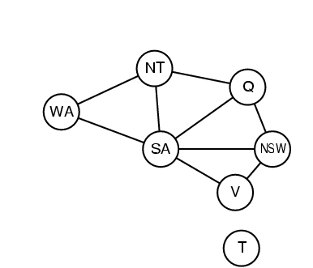
Pattern Matching and CSP
The most constrained variable heuristic used for CSPs would suggest ordering the conjuncts to look for missiles first if there are fewer missiles than objects owned by Nono
We can actually express every finite-domain CSP as a single definite clause together with some associated ground facts
Diff(wa, nt) ∧ Diff(wa, sa) ∧
Diff(nt, q) ∧ Diff(nt, sa) ∧
Diff(nsw, v) ∧ Diff(nsw, v) ∧
Diff(v, sa) → Colorable()
Diff(R, B) Diff(R, G)
Diff(G, R) Diff(G, B)
Diff(B, R) Diff(B, G)

Slide 62
Incremental Forward Chaining
Observation:
Every new fact inferred on iteration t must be derived from at least one new fact inferred on iteration t-1
Modification:
At iteration t, we check a rule only if its premise includes a conjunct p_{i} that unifies with a fact p_{i}’ newly inferred at iteration t-1
Many real systems operate in an “update” mode wherein forward chaining occurs in response to each new fact that is TOLD to the system

Slide 63
Irrelevant Facts
FC makes all allowable inferences based on known facts, even if they are irrelevant to the goal at hand
Similar to FC in propositional context
Solution?

Slide 64
Backward Chaining
p₁ ∧ p₂ ∧… ∧p_{n} ⇒ q
When a query q is examined:
if a matching fact q' is known, return the unifier
for each rule whose consequent q' matches q
attempt to prove each premise of the rule by backward chaining
Backward chaining is the basis for “logic programming,” e.g., Prolog

Slide 65
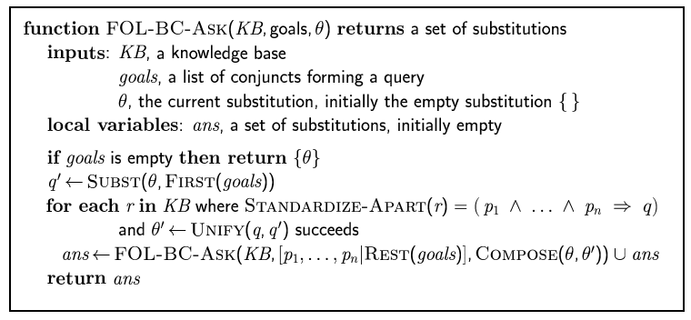
Backward Chaining Algorithm

Slide 66

Backward Chaining Example

Slide 67
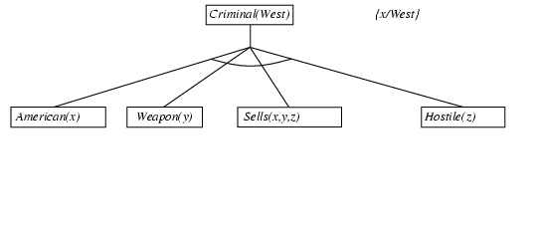
Backward Chaining Example

Slide 68
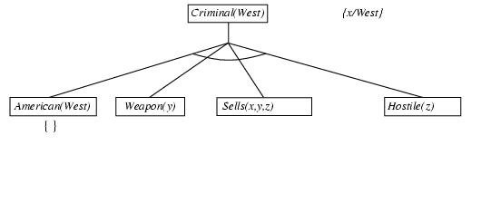
Backward Chaining Example

Slide 69
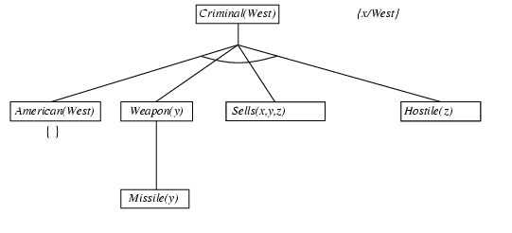
Backward Chaining Example

Slide 70
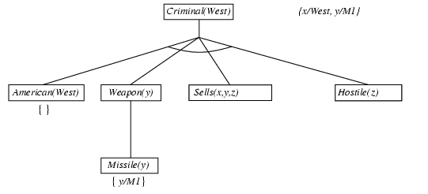
Backward Chaining Example

Slide 71
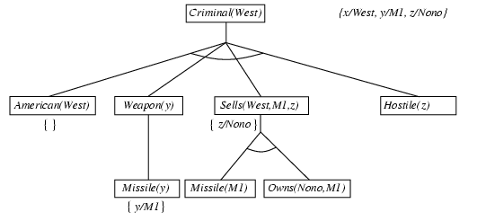
Backward Chaining Example

Slide 72
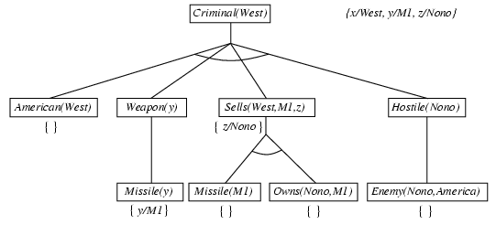
Backward Chaining Example

Slide 73
Analysis of Backward Chaining
Depth-first search: space is linear in size of proof
Repeated states and incompleteness
can be fixed by checking current goal against every goal on stack
Inefficient due to repeated subgoals
can be fixed by caching previous results
Widely used in logic programming

Slide 74
Logic Programming
Prolog
Lisp
Introduced in CS 352 (symbolic programming)
http://www.cs.toronto.edu/~sheila/384/w11/simple-prolog-examples.html

Slide 75
In-Class Exercise #8.5
Write down logical representations for the following sentences, suitable for use with Generalized Modus Ponens
Horses, cows, and pigs are mammals.
An offspring of a horse is a horse.
Bluebeard is a horse.
Bluebeard is Charlie’s parent.
Offspring and parent are inverse relations.
Draw the proof tree generated by exhaustive backward-chaining algorithm for the query ∃h Horse(h), where clauses are matched in the order given.

